Slide 1
Cloud Computing
SEWP ZG527

Slide 2
VM Provisioning and Migration

Slide 3
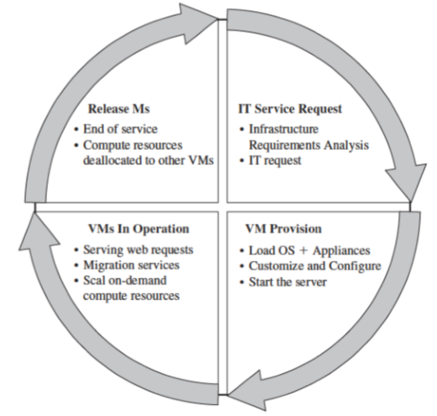
Virtual Machine Provisioning and Manageability Life Cycle
• The cycle starts by a request delivered to the IT department, stating the requirement for creating a new server for a particular service.
• This request is being processed by the IT administration to start seeing the servers’ resource pool, matching these resources with requirements
Starting the provision of the needed virtual machine.
• Once it provisioned and started, it is ready to provide the required service according to an SLA(Service Level agreement ).
• Virtual is being released; and free resources.
Virtual Machine Life Cycle

Slide 4
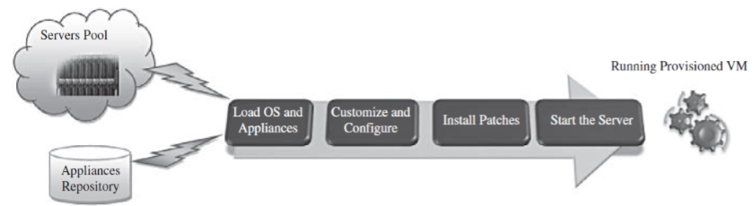
VM Provisioning Process
Steps to Provision VM -
Select a server from a pool of available servers along with the appropriate OS template you need to provision the virtual machine.
• Load the appropriate software.
Customize and configure the machine (e.g., IP address, Gateway) to an associated network and storage resources.
• Finally, the virtual server is ready to start with its newly loaded S/W.

Slide 5
VM Provisioning
Server provisioning is defining server’s configuration based on the organization requirements, a H/W, and S/W component (processor, RAM, storage, networking, operating system, applications, etc.).
VMs can be provisioned by
Manually installing an OS,
Using a preconfigured VM template,
Cloning an existing VM, or importing a physical server or a
Server from another hosting platform.
Physical servers can also be virtualized and provisioned using P2V (Physical to Virtual)

Slide 6
VM Provisioning using templates
• Provisioning from a template reduces the time required to create a
new virtual machine.
• Administrators can create different templates for different purposes.
For example –
Vagrant provision tool using VagrantFile (template file) (demo)
Heat – Orchestration Tool of openstack (Heat template in YAML format)
(demo – Instance creation in cloud, Load balancer in cloud)
This enables the administrator to quickly provision a correctly configured virtual server on demand.

